Slide 1

REAL SCENARIO:
2025

Slide 2

REAL SCENARIO:
Scanned documents (citizenship, NID, PAN etc.)
2025

Slide 3


FIXING THE “BAD REQUEST”
By Team Bad Request

Slide 4


Upload
Wait

Slide 5

error message: “We couldn’t process your documents.”.

Slide 6
WHY NEPALESE BANKS ARE STRUGGLING?

Slide 7



Scanned documents (citizenship, utility bill, income proof)
Slow processing = poor responsiveness
Loan approval times

Slide 8
IT’S NOT THE LOAN. IT’S THE DOCUMENTS

Slide 9



Manual reviews of poor scans
Misfiled or unopenable documents
Over 40% of dissatisfaction tied to service quality and communication gaps

Slide 10




AI-powered MergeDocs processes messy, tilted, multilingual documents—turning blurry PDFs into approvals in seconds, not days.

Slide 11
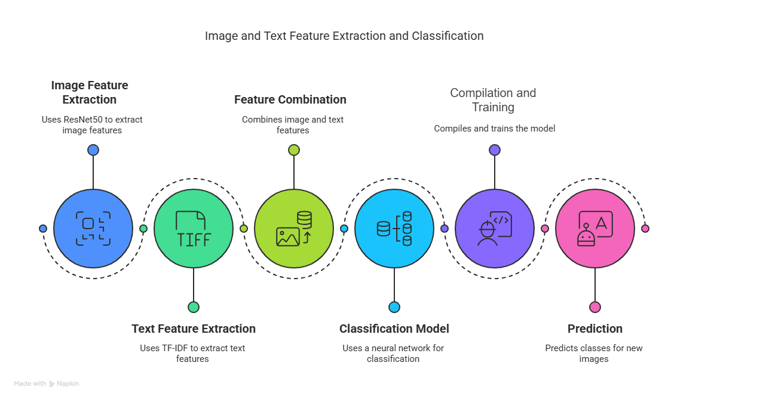
MODEL ARCHITECTURE

Slide 12
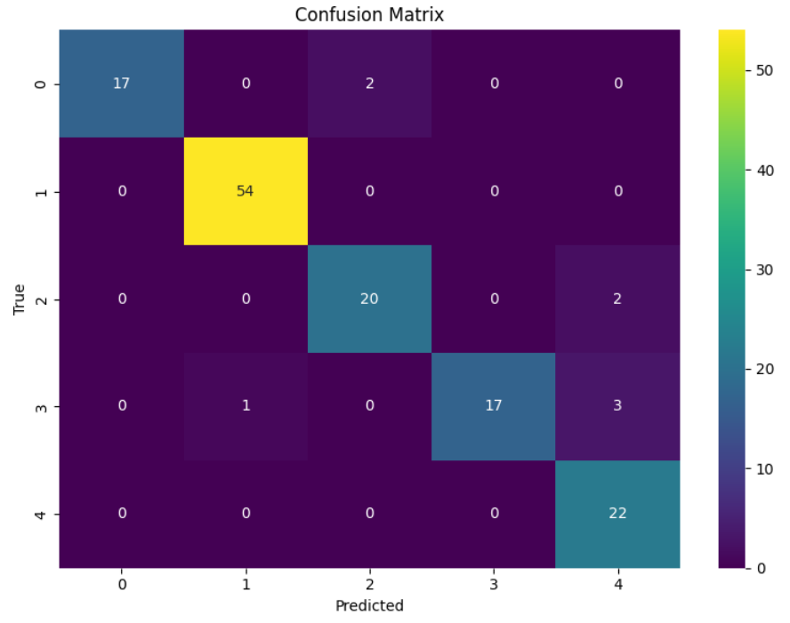
96%
Accuracy
93%
Weighted Avg

Slide 13

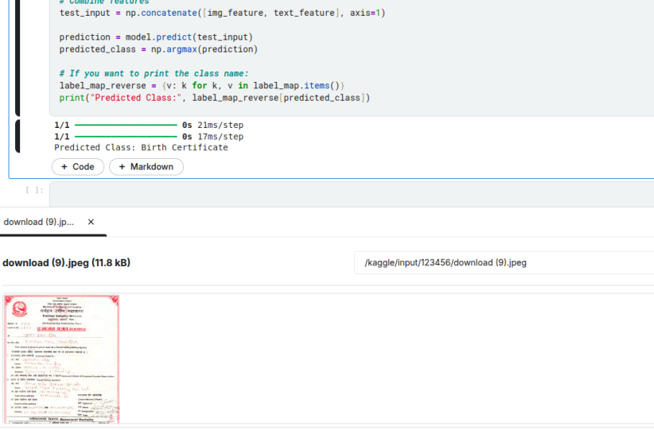


Slide 14
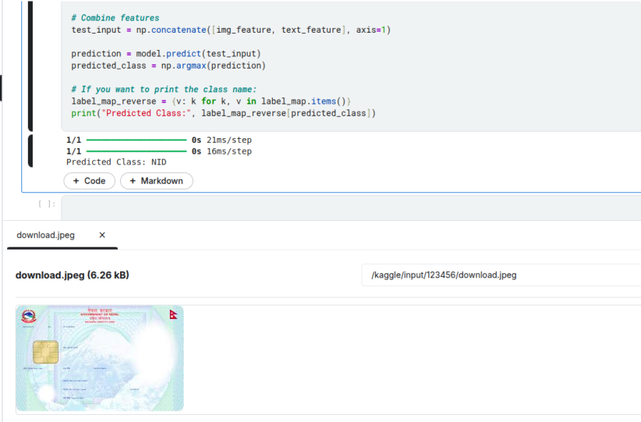

Slide 15
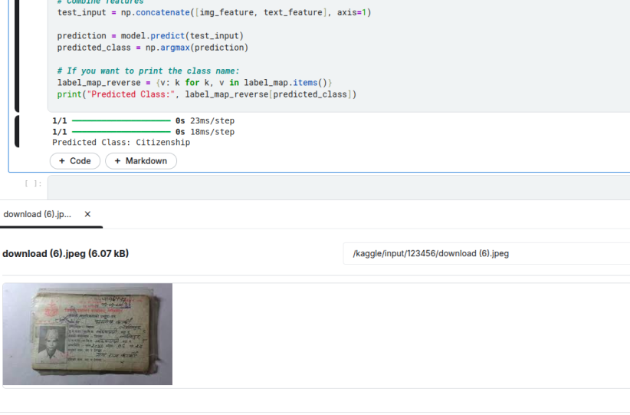

Slide 16
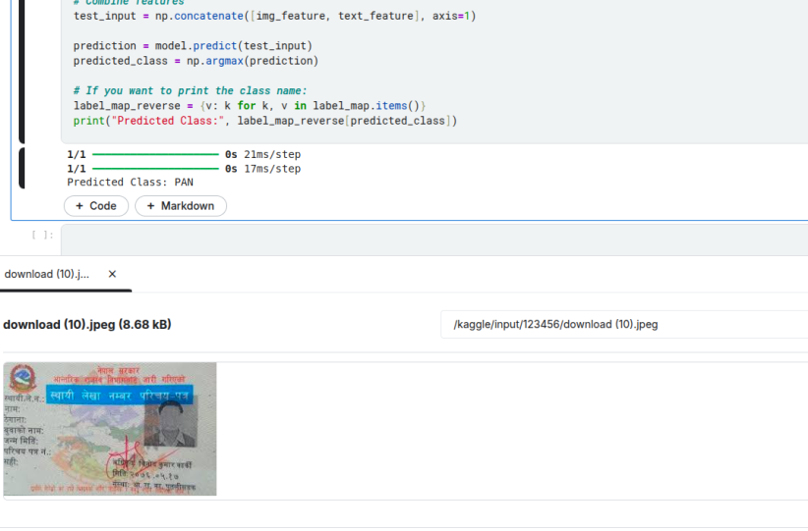

Slide 17


BUSINESS MODEL
SaaS Product
APIs as Service
Freemium with Add-Ons

Slide 18
THANK YOU!

Slide 19
ANY QUESTIONS?!

